Slide 1
WebGIS Final Project: GeoJobs
Yiran Li
yiran383@tamu.edu
Customer: Dr. Goldberg

Slide 2
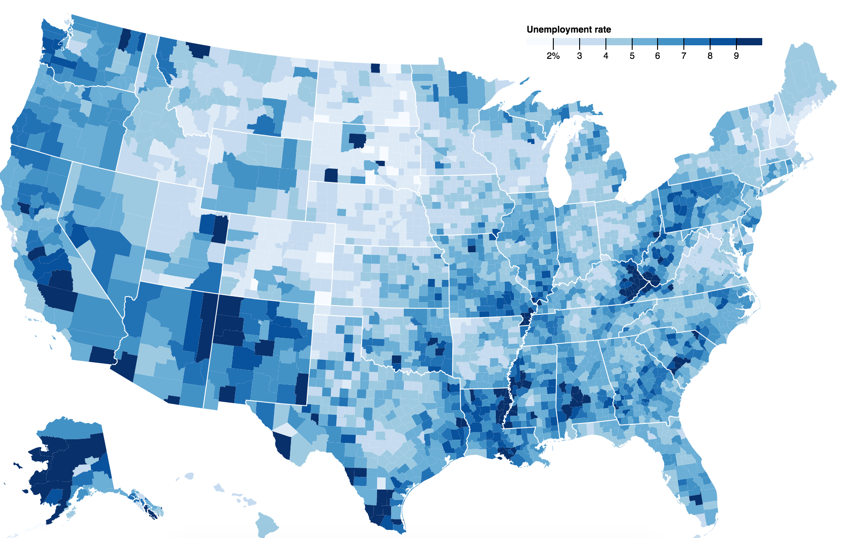
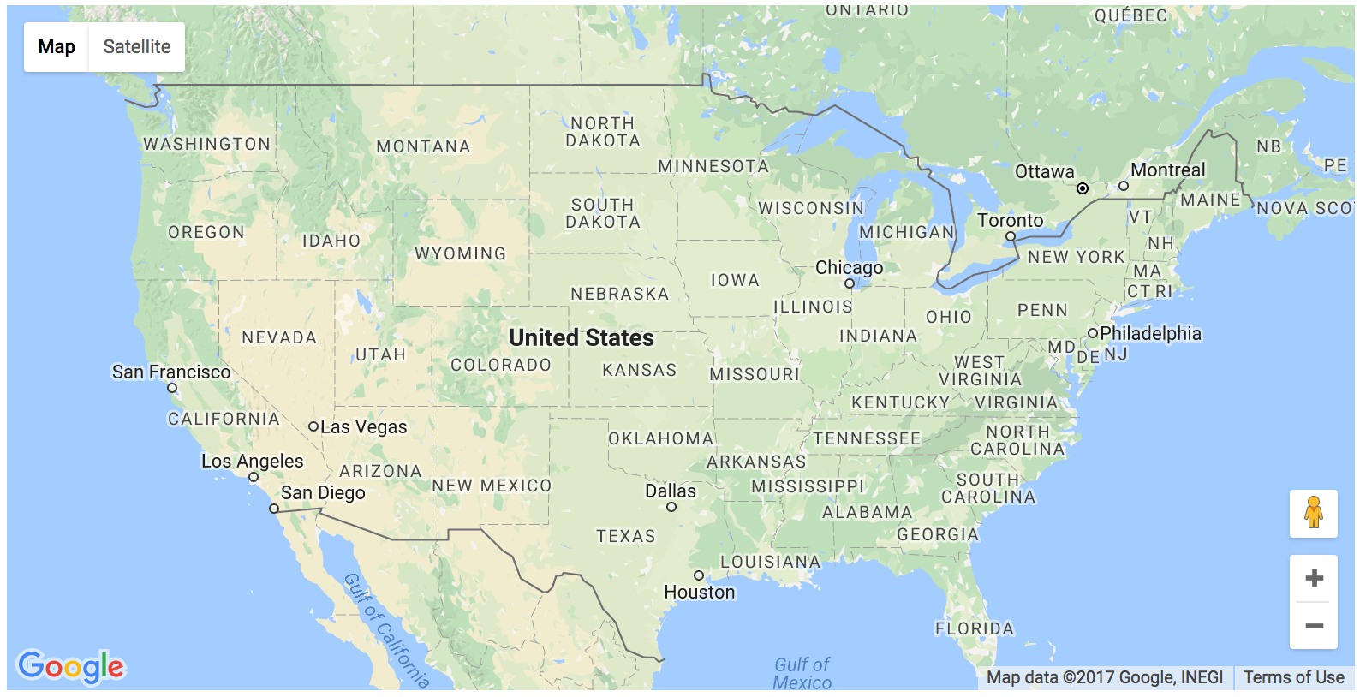
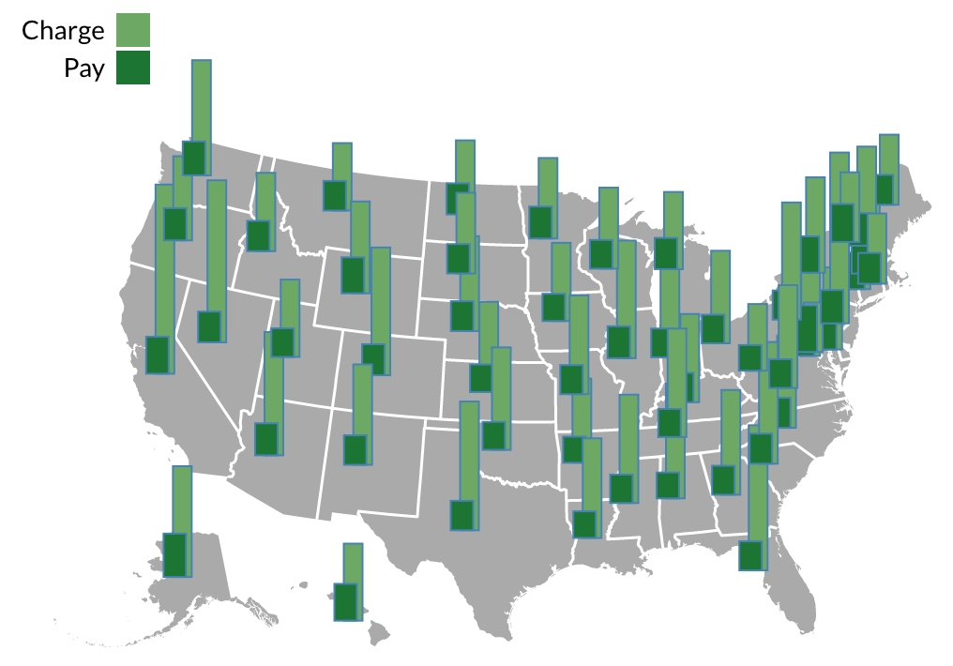
Goals
Explore the potential of bringing d3.js and Google Map API together
Create beautiful and powerful interactive web map to visualize data from Dr. Goldberg’s Geojob database

Slide 3
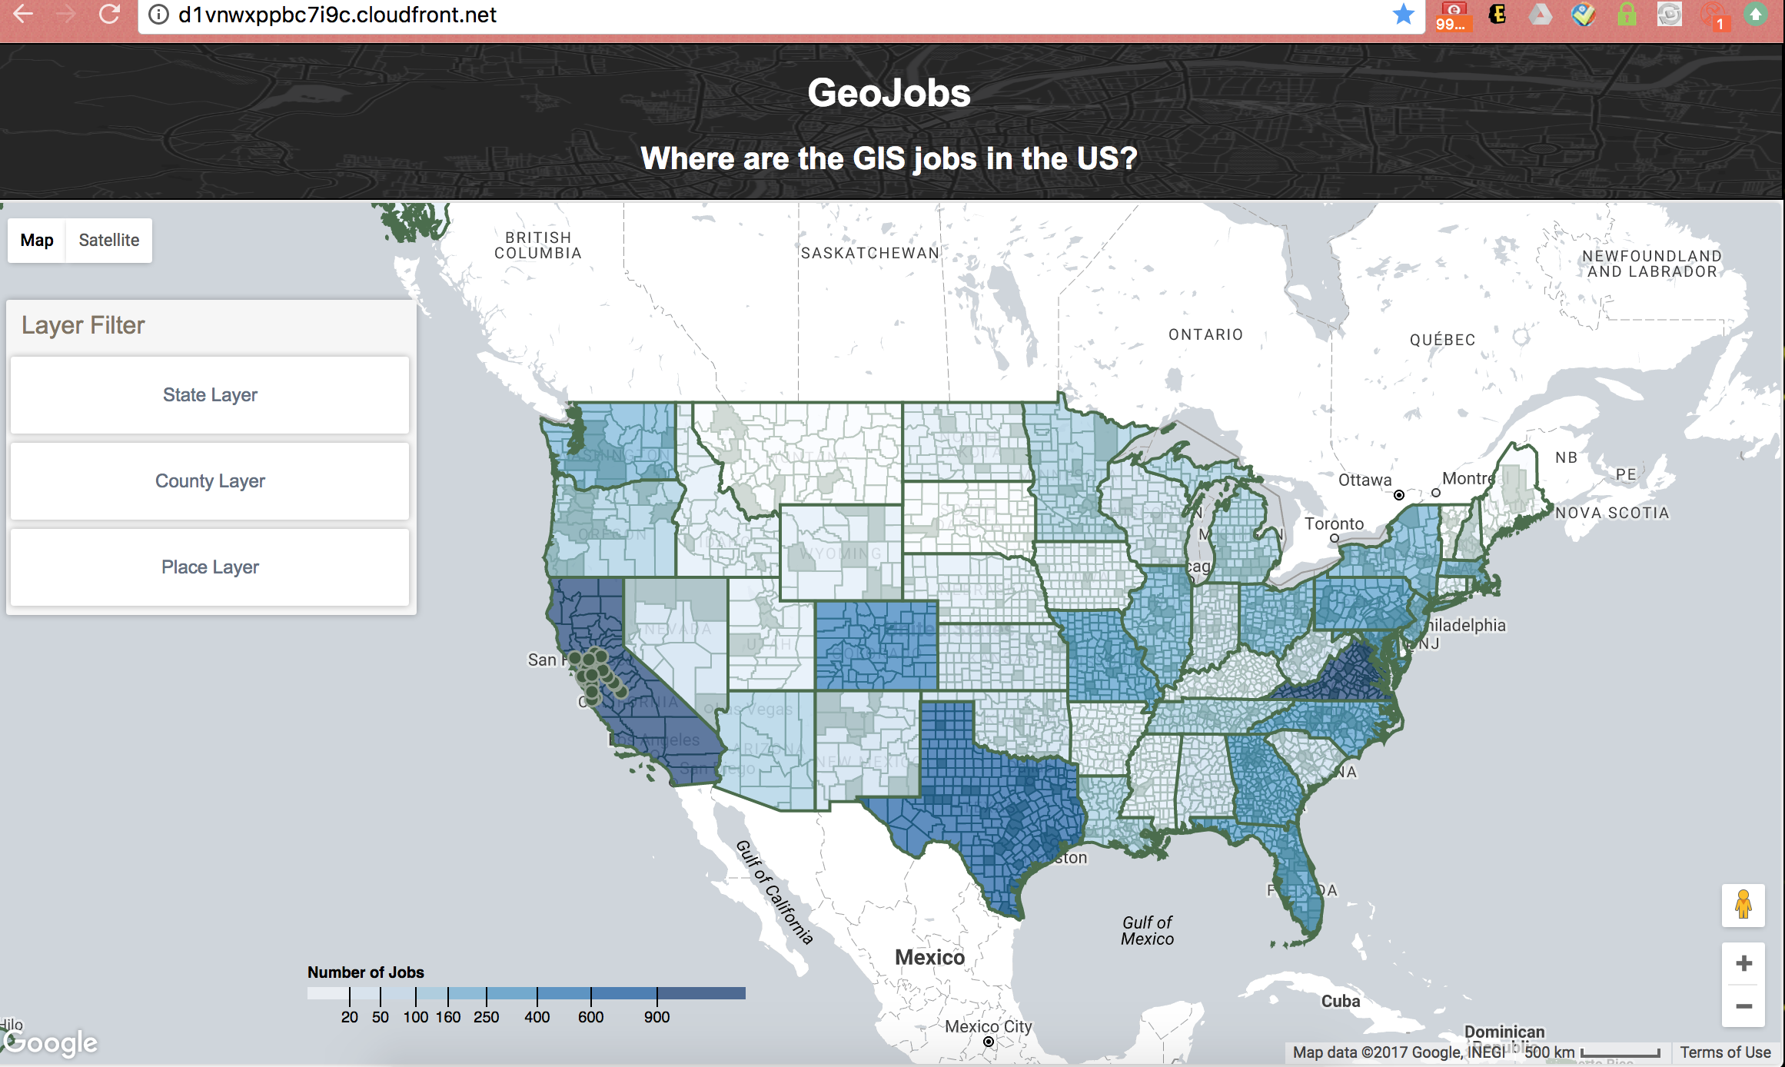
Deliverable
A user-friendly interactive web map hosted on Amazon Web Sever that anyone can access it anytime from anywhere: http://d1vnwxppbc7i9c.cloudfront.net/
Notes:
In case you wanna access the webpage anytime through out the presentation.

Slide 4
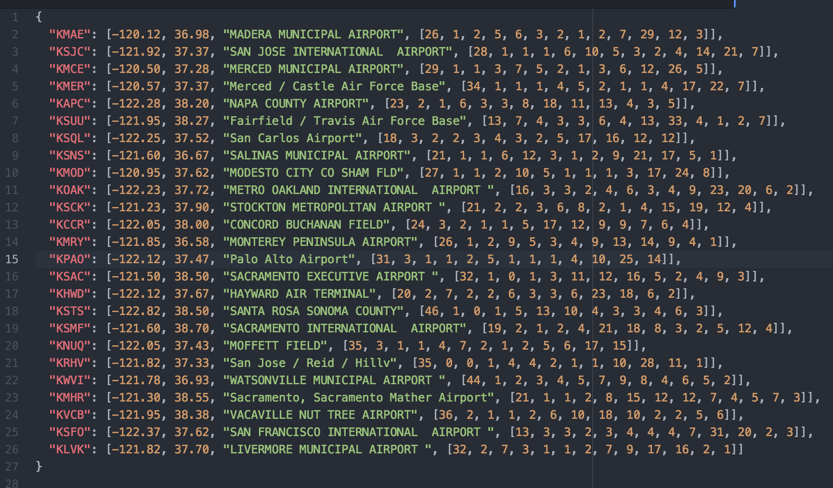
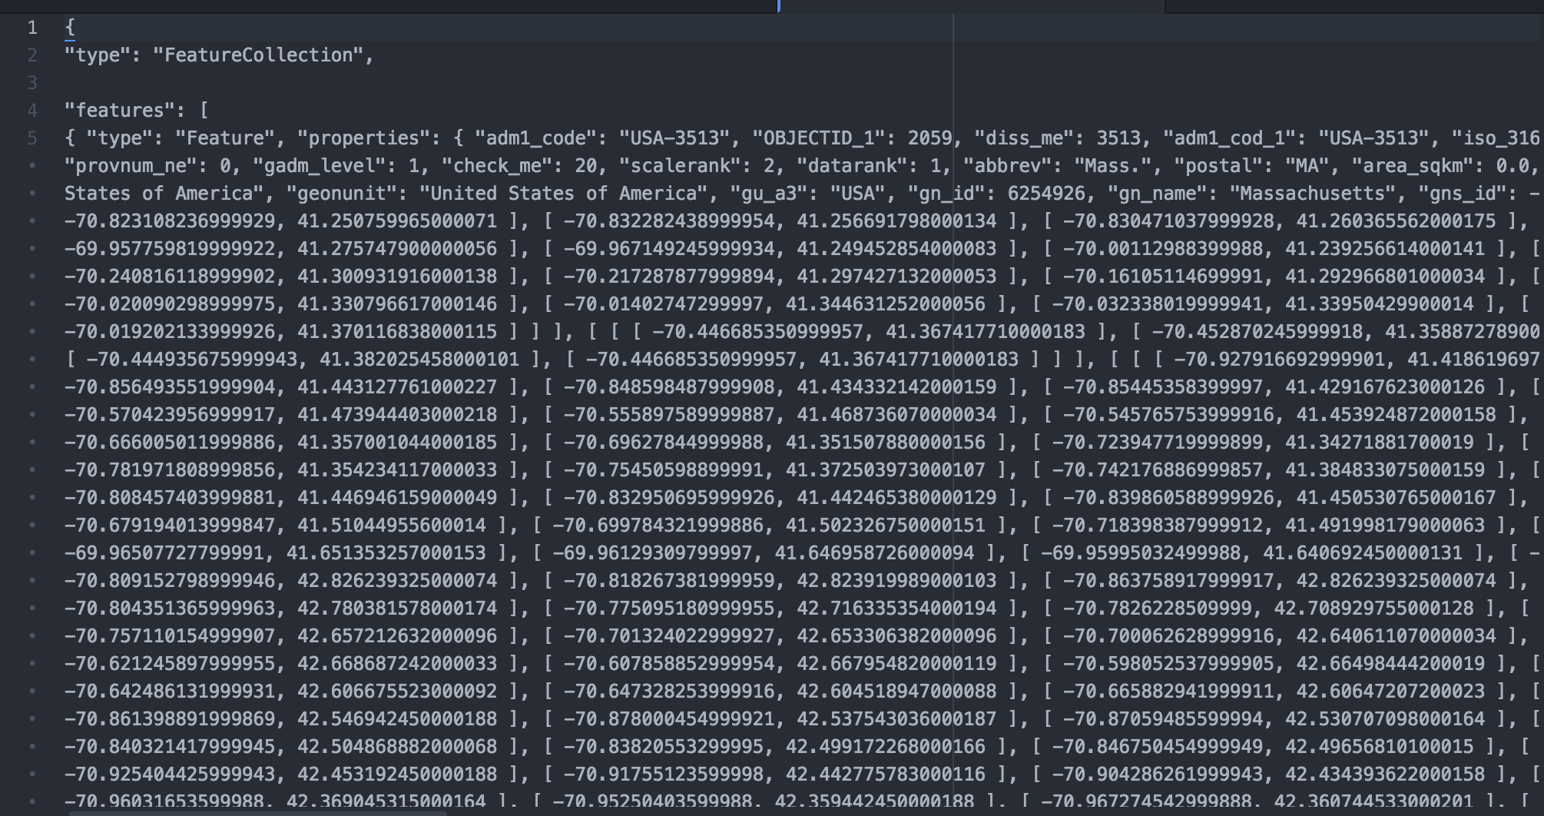
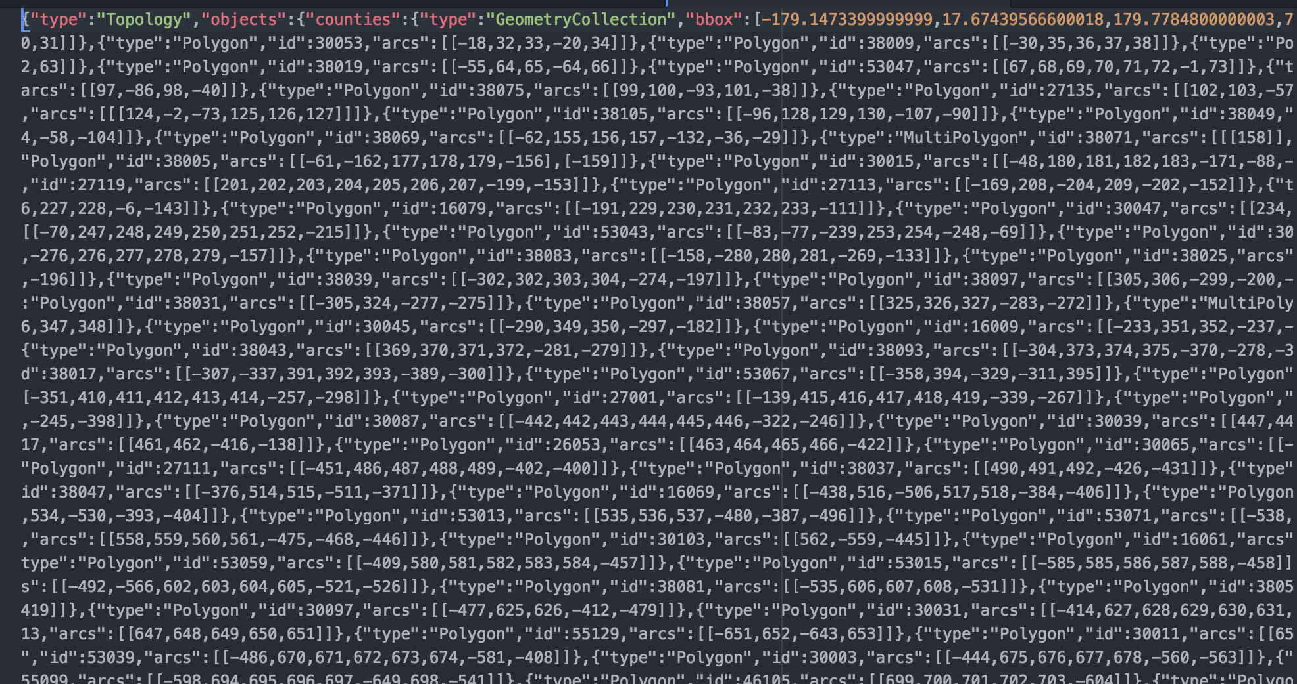
Challenges and Solutions
Align D3 SVG with the Google map
Google map: OverlayView → OverlayMouseTarget
D3.js: bind data driven SVGs to OverlayMouseTarget pane
Retrieve the projection from Google map (fromLatLngToDivPixel) and set it to D3 layer
Work with JSON, GeoJSON and TopoJSON
Points: ordinary JSON
States: GeoJSON
Counties: TopoJSON
Advantages: topology and size (657KB vs. 205.2MB)
http://d1vnwxppbc7i9c.cloudfront.net/
Notes:
TopoJSON eliminates redundancy, allowing related geometries to be stored efficiently in the same file. Ex. geometries in TopoJSON files are stitched together from shared line segments called arcs

Slide 5
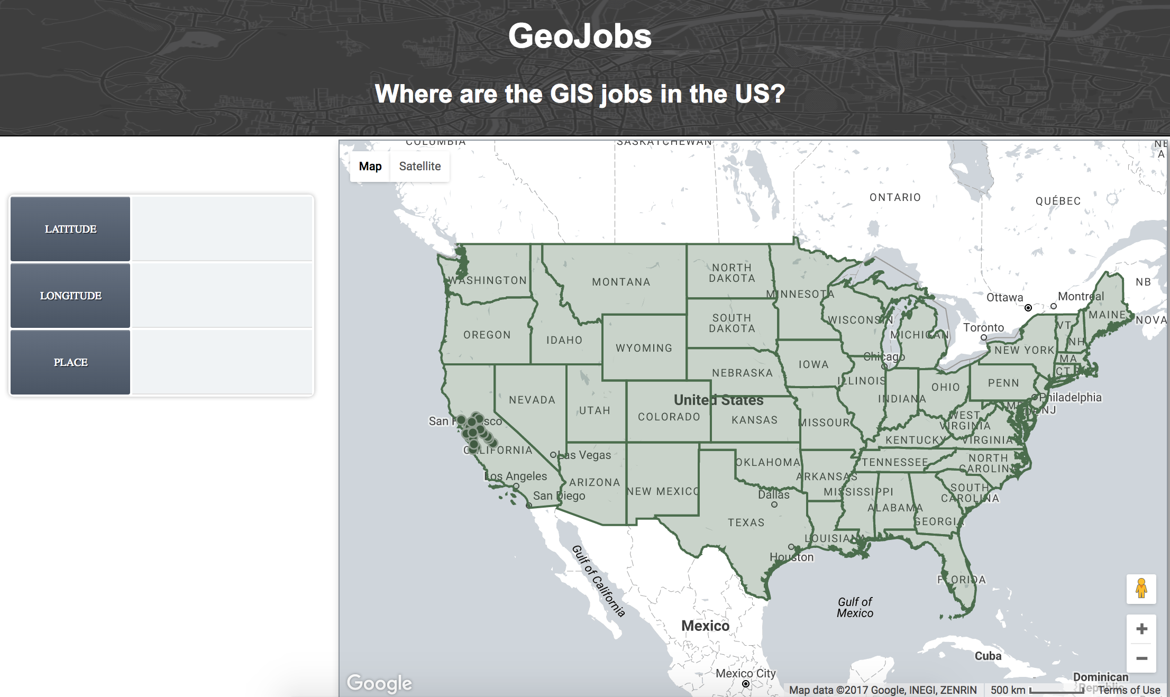
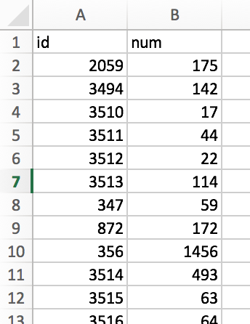
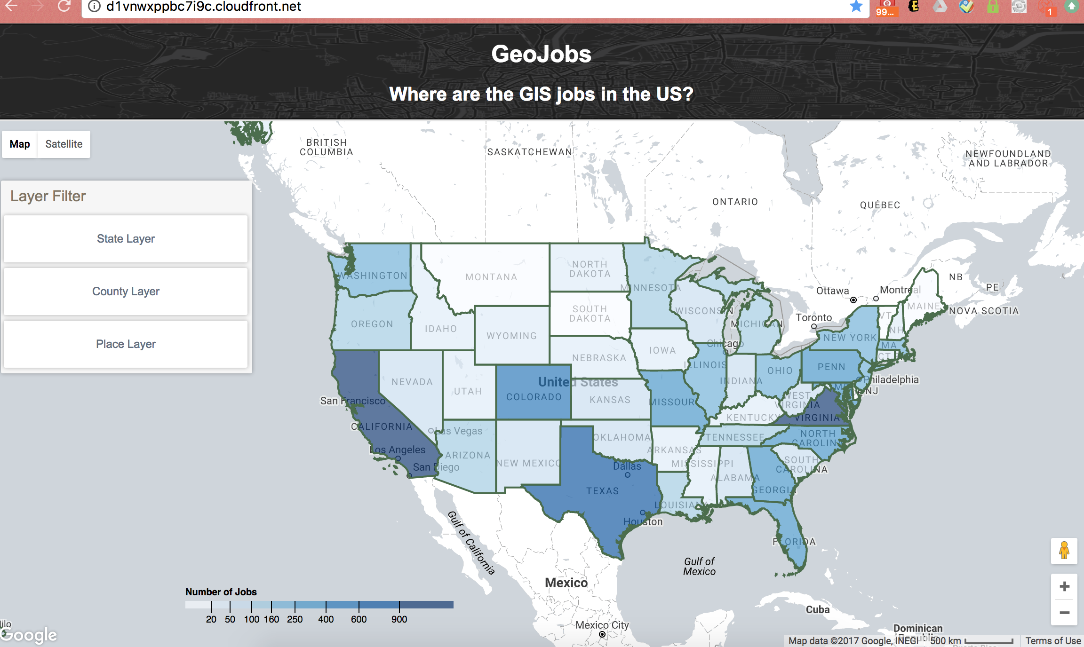
Challenges and Solutions
Choropleth and legend
A dictionary was created to map state id and number of jobs
Mouse event
click, mouseover, mosemove, moseout
DOM element select, remove, append (bound to button click event)
http://d1vnwxppbc7i9c.cloudfront.net/
Notes:
A dictionary was created to map state id (shared by geojson and tsv text file) and number of jobs.
Tooltip is offset relative to the position of mouse.

Slide 6
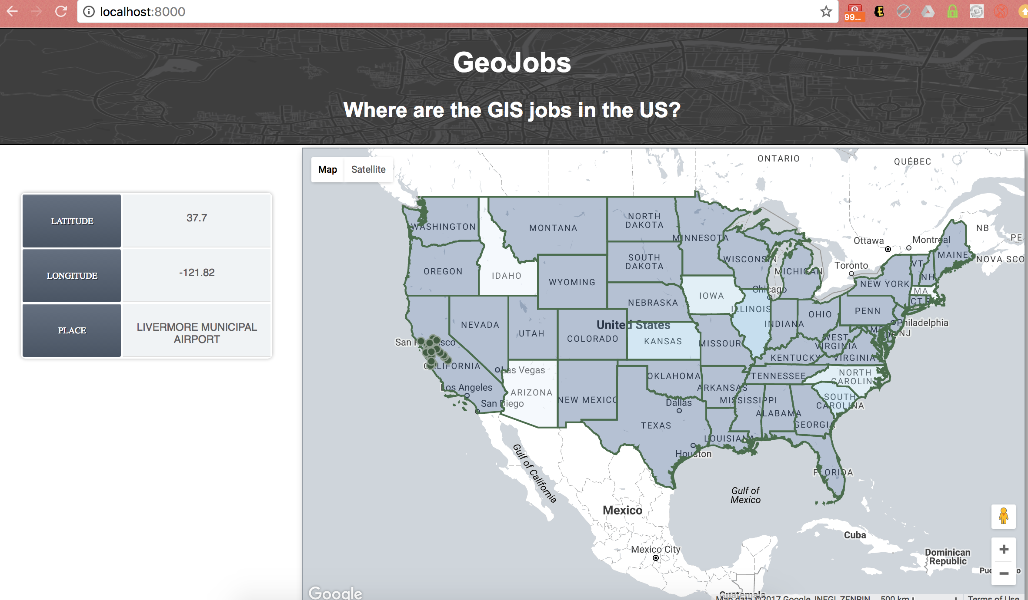
Challenges and Solutions
UI design
Add layer filter panel, hide table when document load the first time, change google map style
BEFORE
AFTER
http://d1vnwxppbc7i9c.cloudfront.net/
Notes:
Layer filter, table is hidden at the beginning and will show up once user click on the points.
Change google map style to make it …

Slide 7
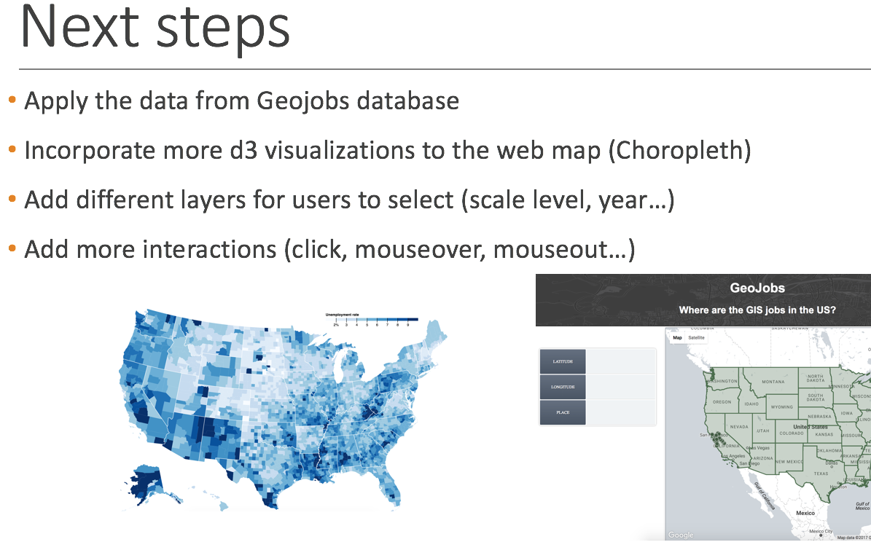
Conclusion
All the tasks in the next steps from status report has been accomplished
Future works:
Automatically switch between state and county layer at different zoom level/ Cluster points
Improve the UI
Connect to database/ server side programming
Notes:
Retrieve data directly from database

